Slide 1
CS551 Final Project
David LI

Slide 2
Overview
Original Project
Gathering Data
Formatting Data
Correlation Analysis
Manual Models
AutoML
Exporting Result
Retrospective
Extra(?): Streamlit Interface

Slide 3
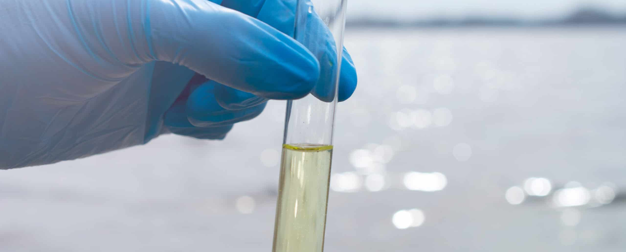
Question: Can you use the chemical composition of water to predict its quality

Slide 4
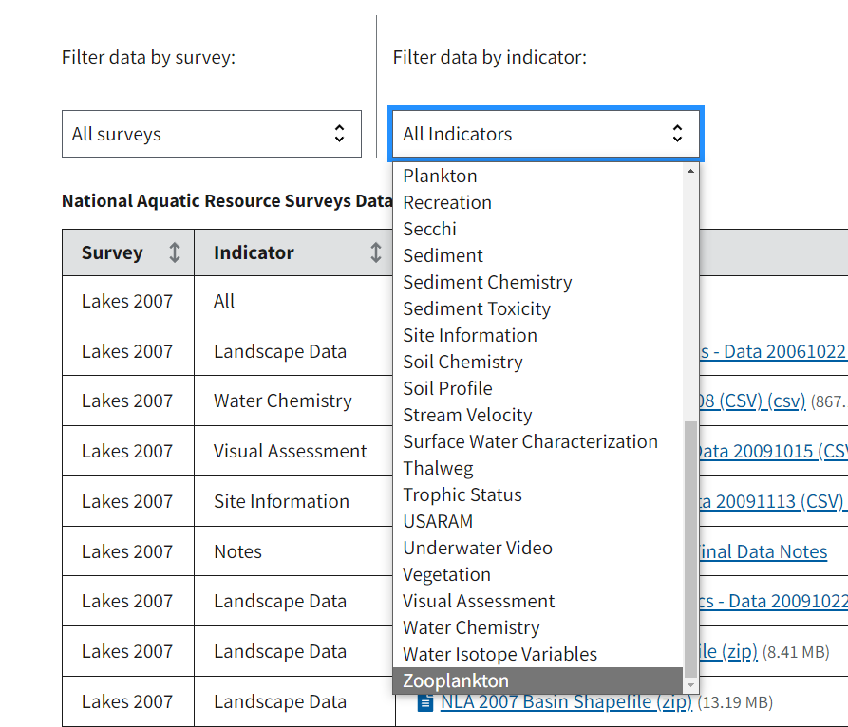
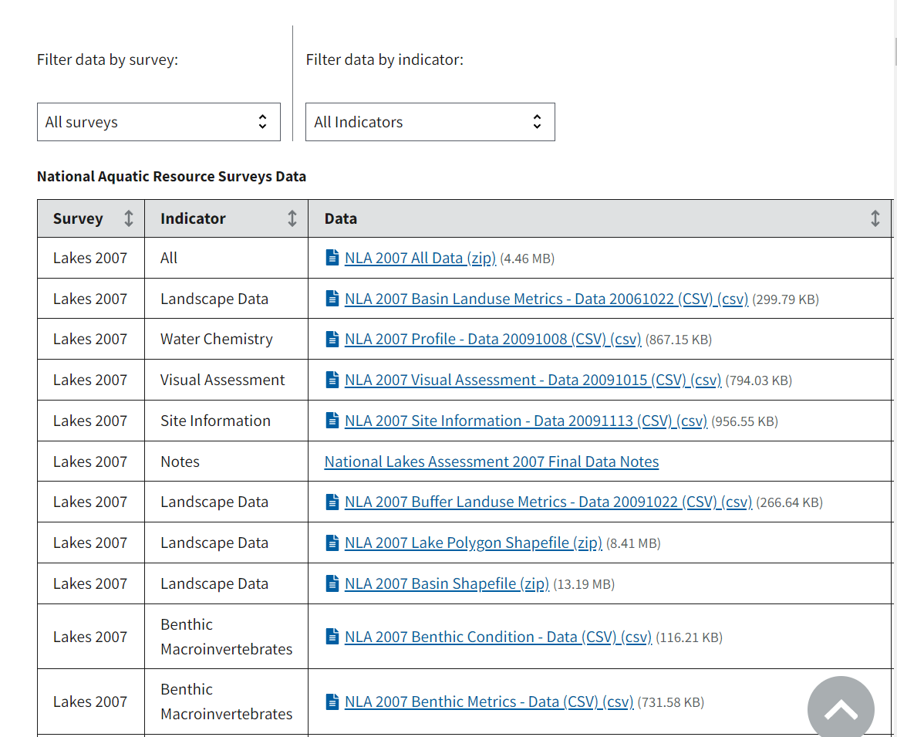
Gathering Data: EPA Website
https://www.epa.gov/national-aquatic-resource-surveys/data-national-aquatic-resource-surveys

Slide 5
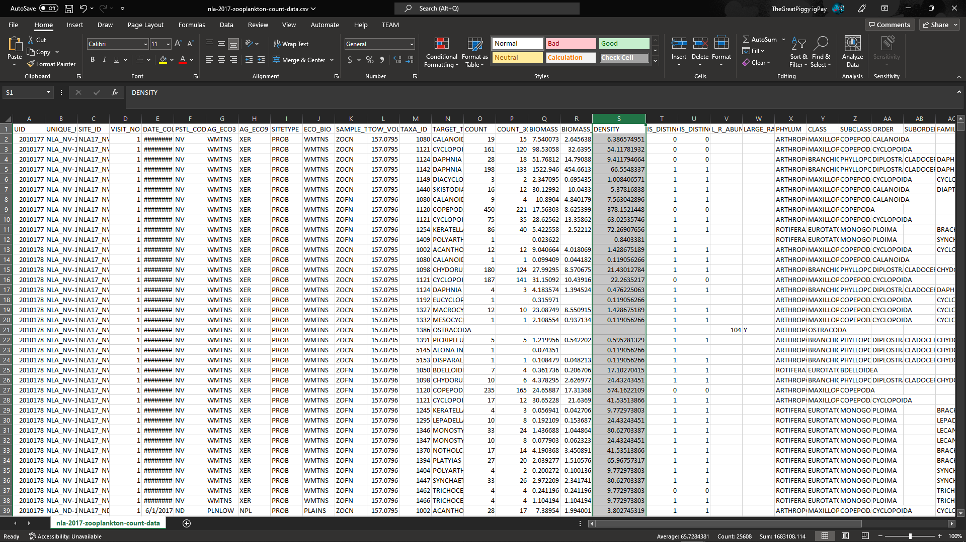
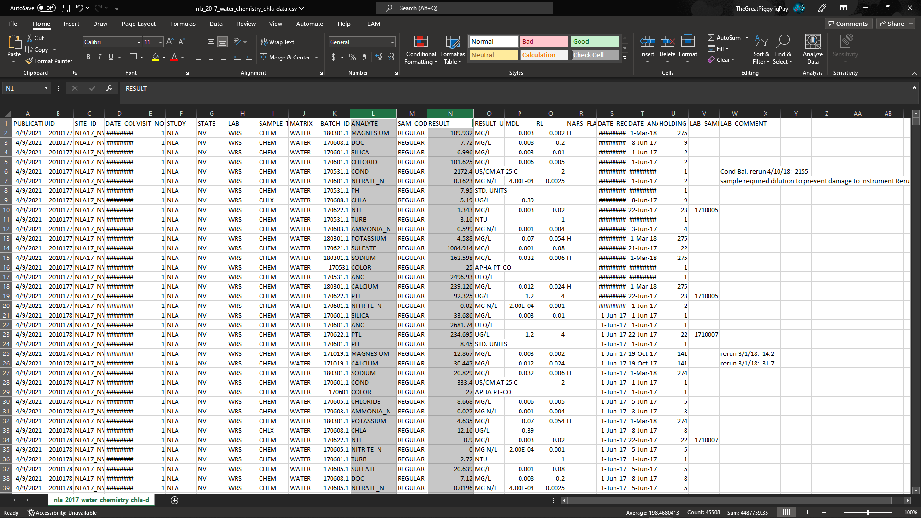
Original Project: Choosing Tables

Slide 6
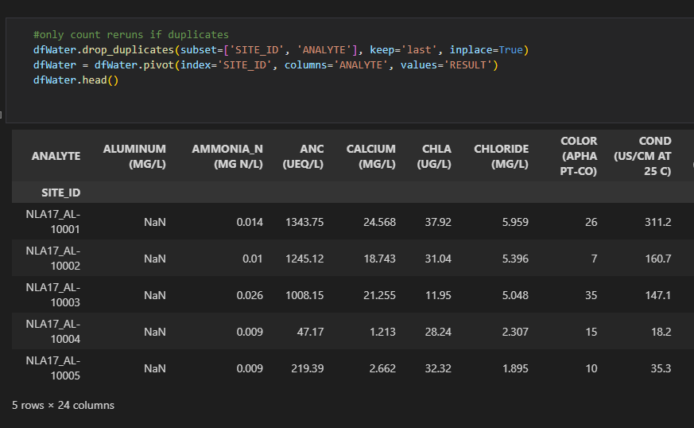
Original Project: Formatting Data
2 dataframes: dfWater, dfZooplankton
SITE_ID as df index

Slide 7
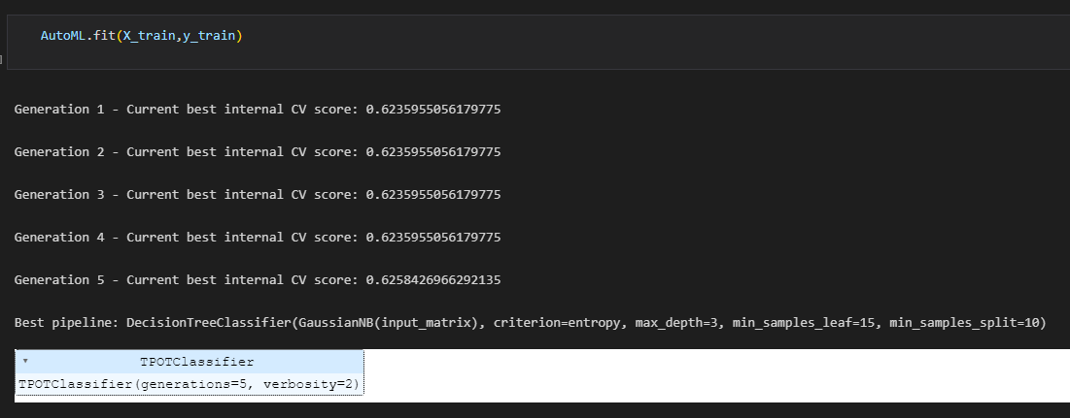
Original Project: Results
Not enough datapoints for an accurate model
Only ~1100

Slide 8
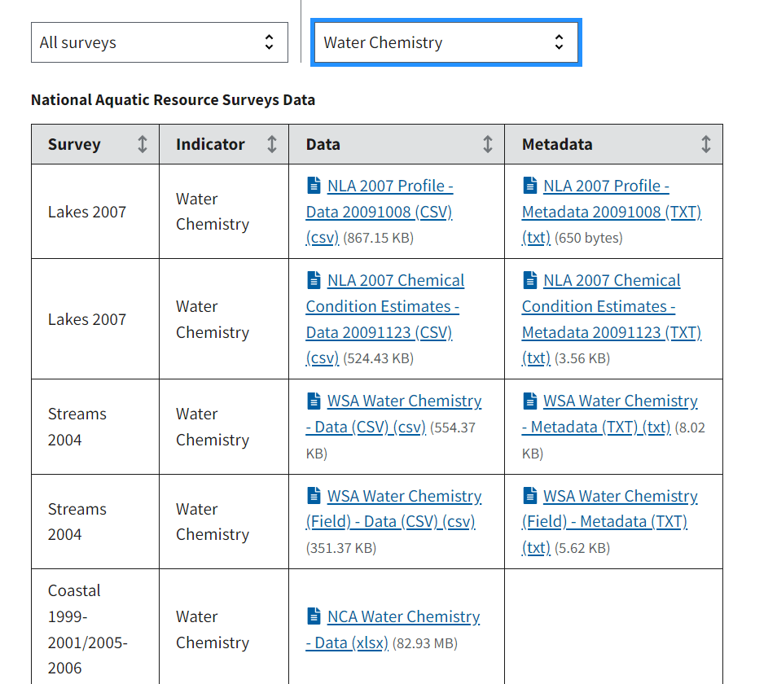
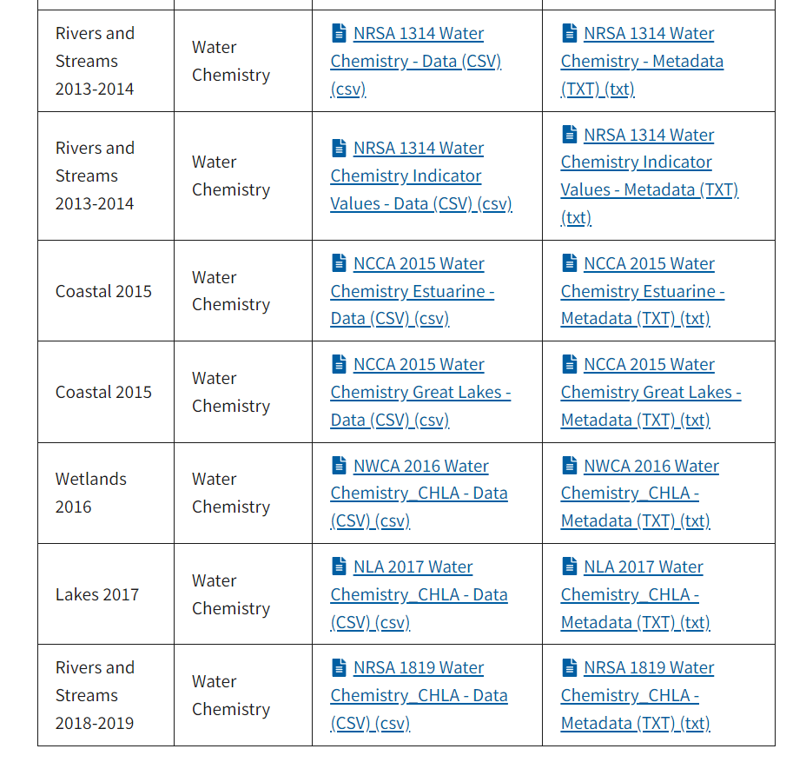
Gathering Data: Back to EPA Website

Slide 9
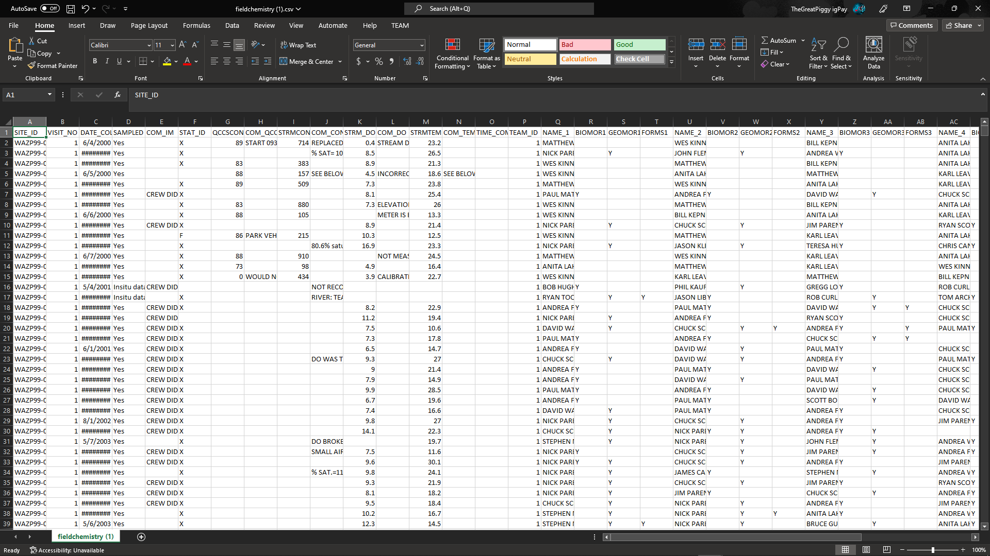
Gathering Data: Analyzing Tables (1/4)
Unrelated
Old
Column-Organized
Wide-Organized

Slide 10
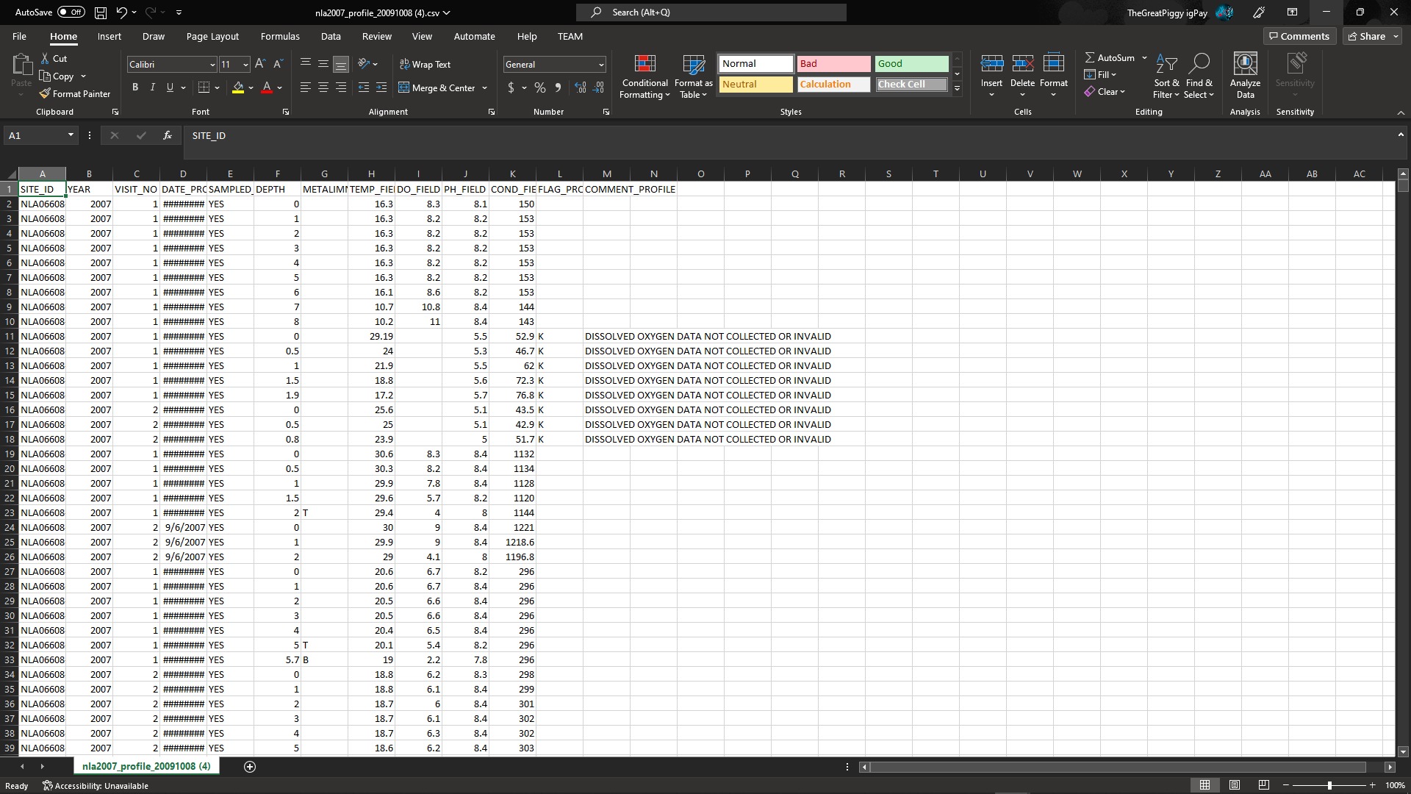
Gathering Data: Analyzing Tables (2/4)
Unrelated
Old
Column-Organized
Wide-Organized

Slide 11
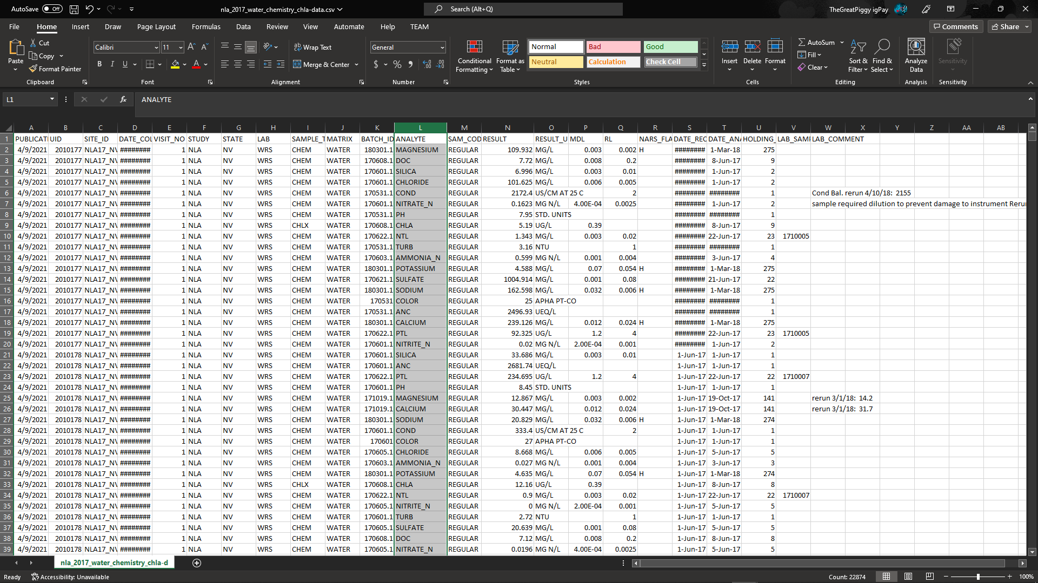
Gathering Data: Analyzing Tables (3/4)
Unrelated
Old
Column-Organized
Wide-Organized

Slide 12
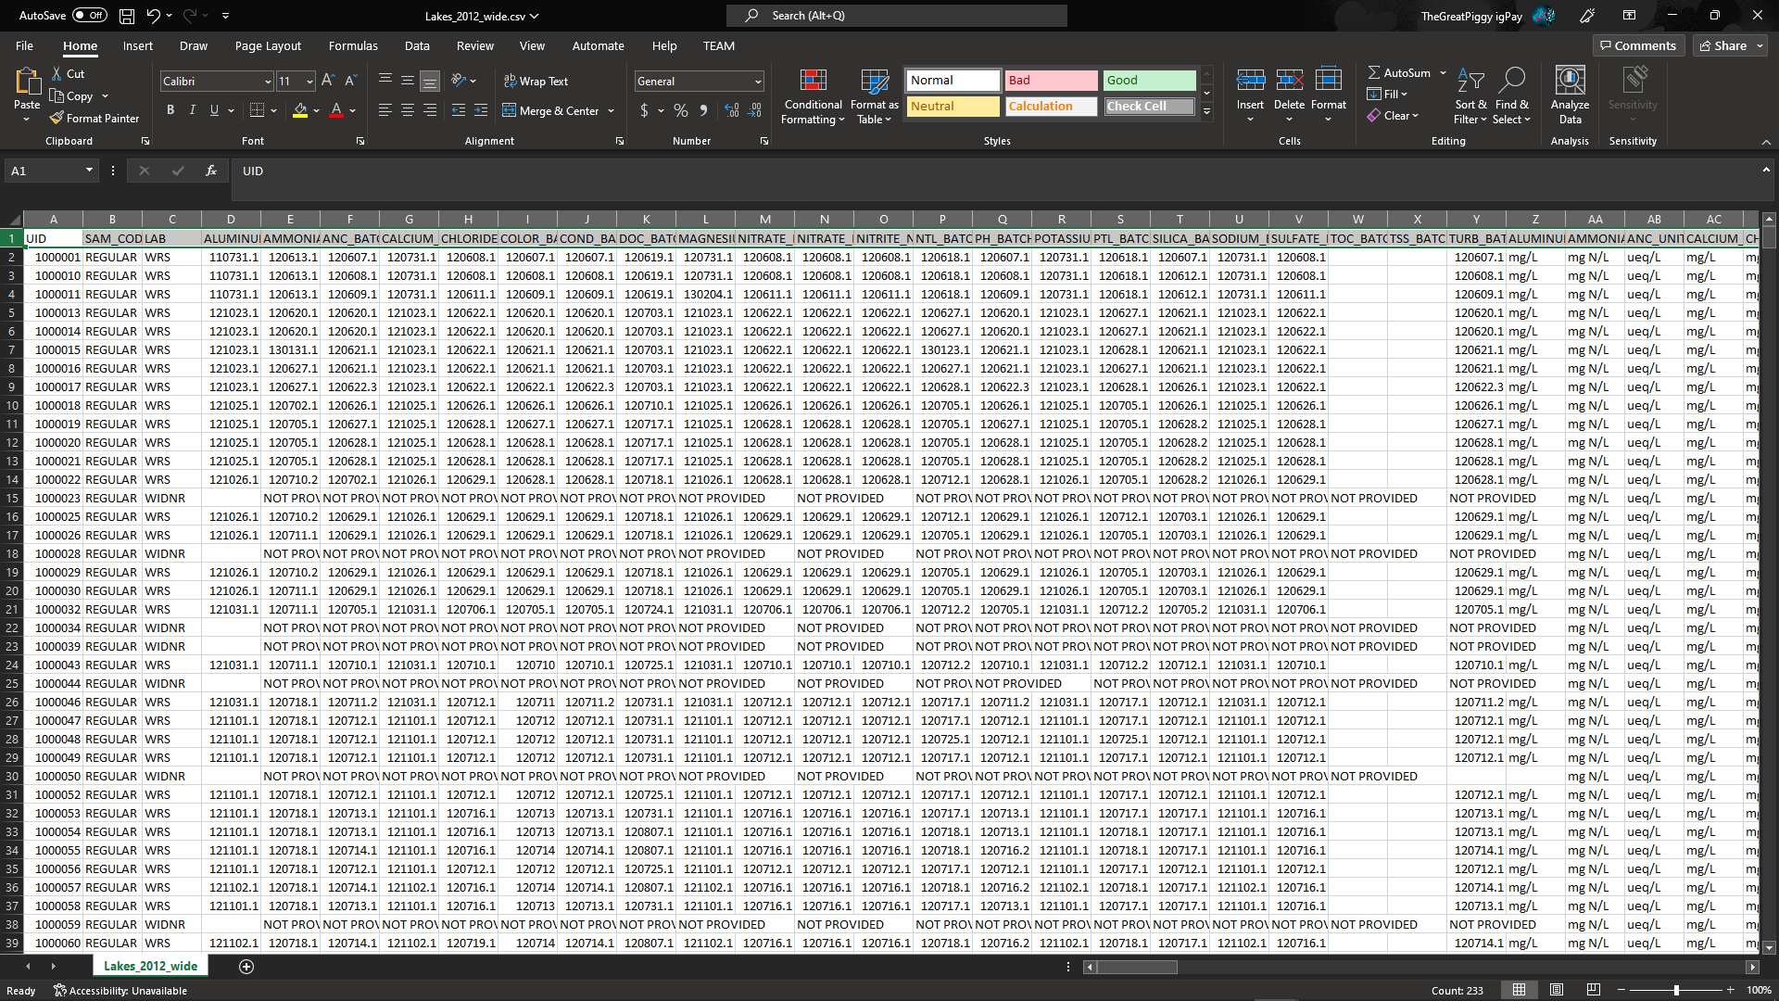
Gathering Data: Analyzing Tables (4/4)
Unrelated
Old
Column-Organized
Wide-Organized

Slide 13
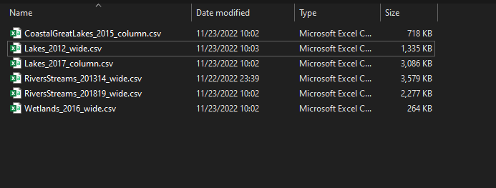
Gathering Data: File Organization
6 sets total (~8000 datapoints)
Seemingly enough at the time

Slide 14
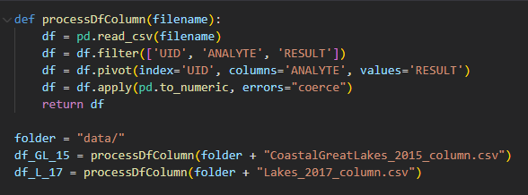
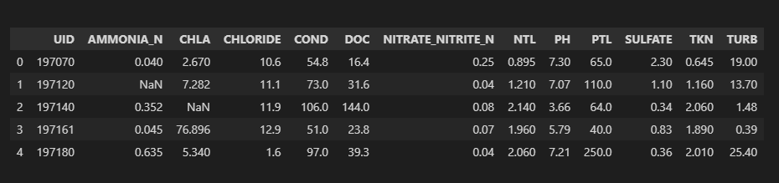
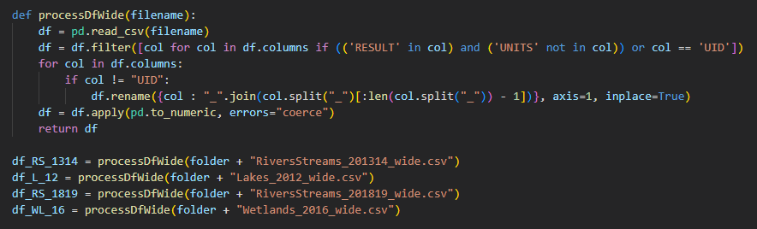
Formatting Data: Standardizing Tables

Slide 15
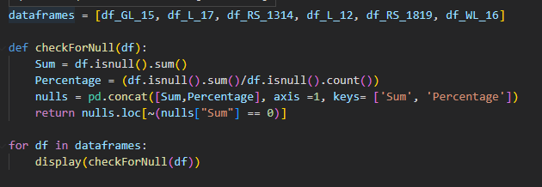
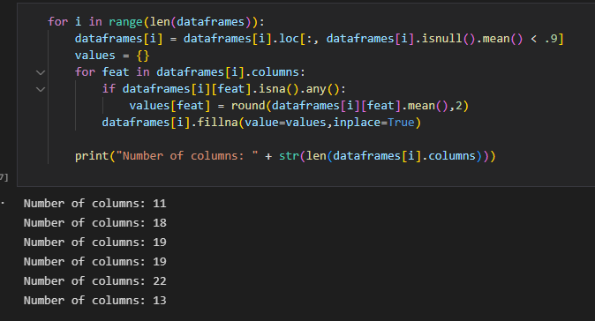
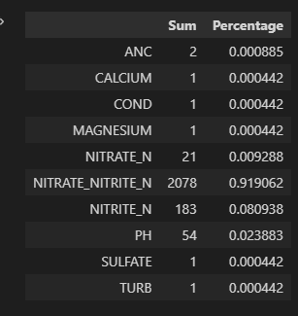
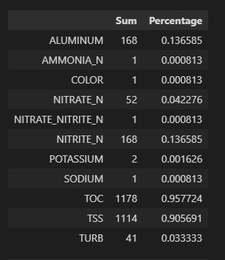
Formatting Data: Dealing With Nulls

Slide 16
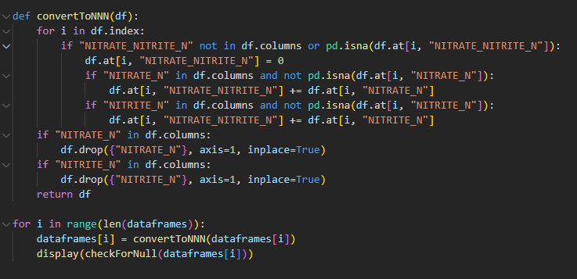
Formatting Data: Nitrate/Nitrite Processing

Slide 17
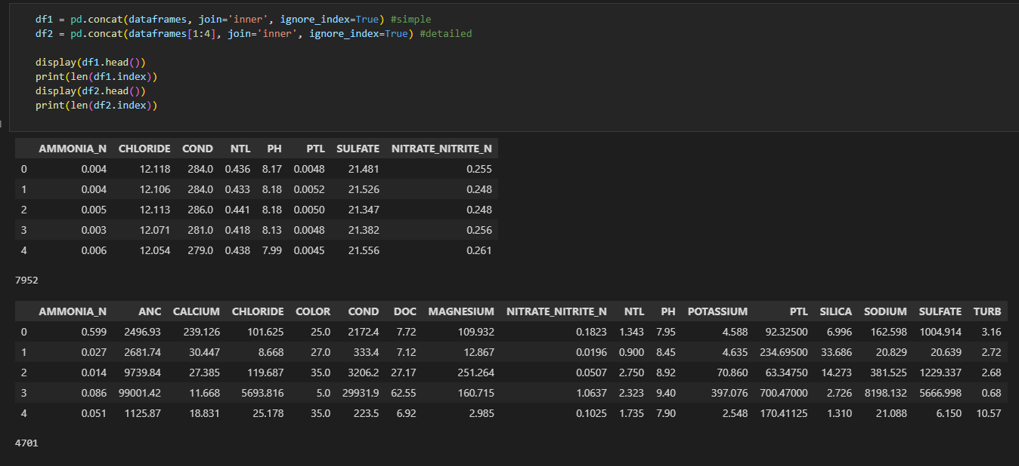
Formatting Data: Dataframe Concatenation
Two dataframes:
df1 and df2

Slide 18
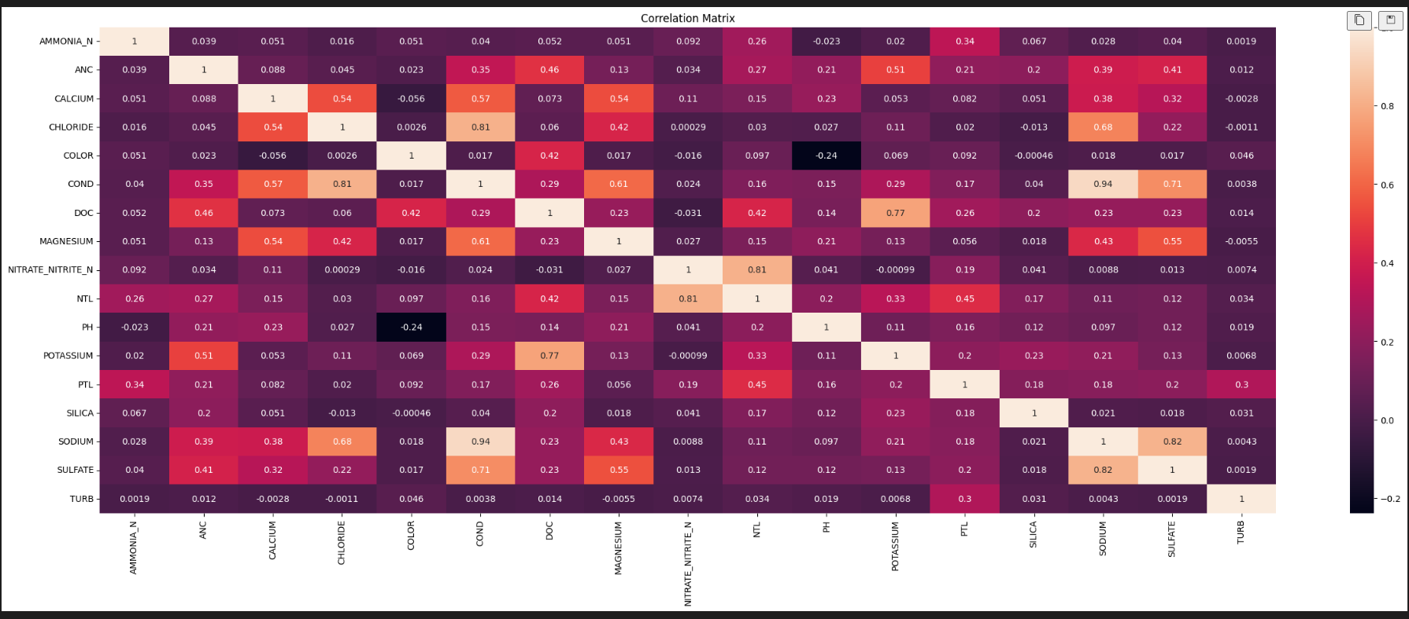
Correlation Plots and Analysis

Slide 19
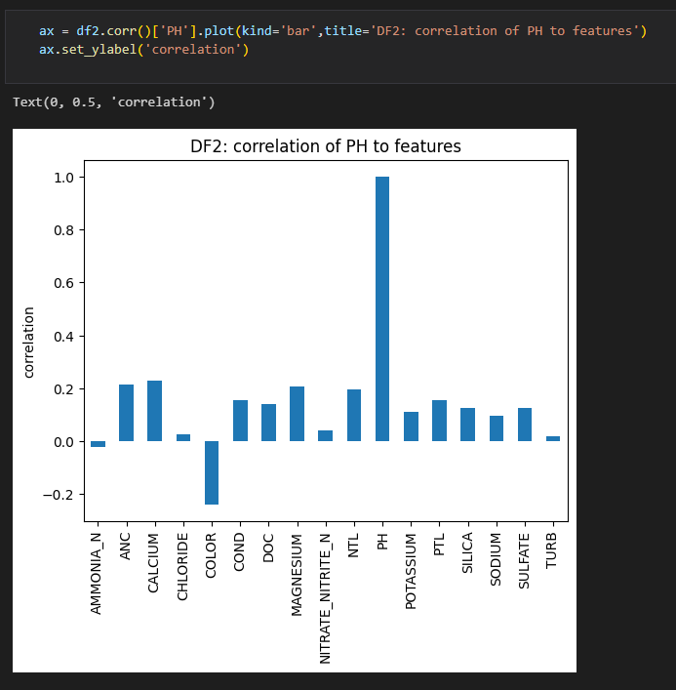
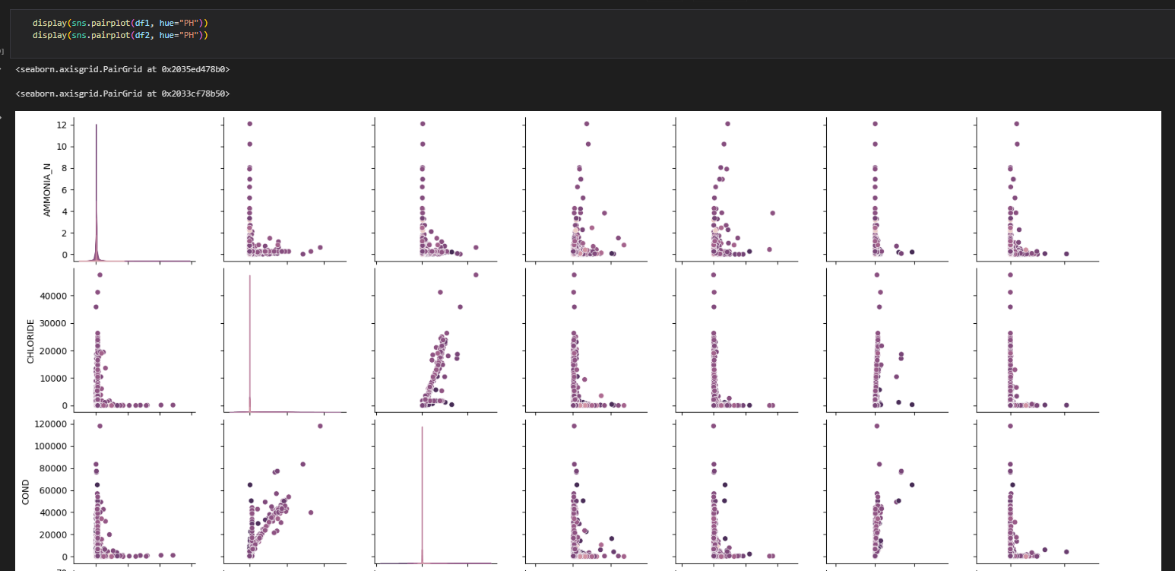
Correlation Plots and Analysis (cont.)

Slide 20
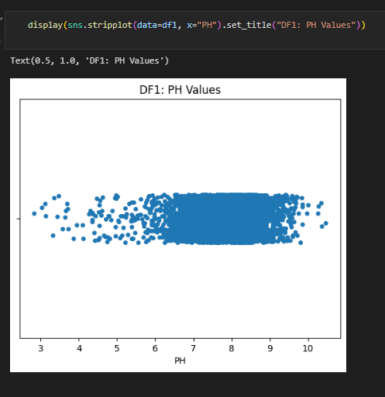
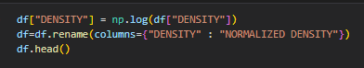
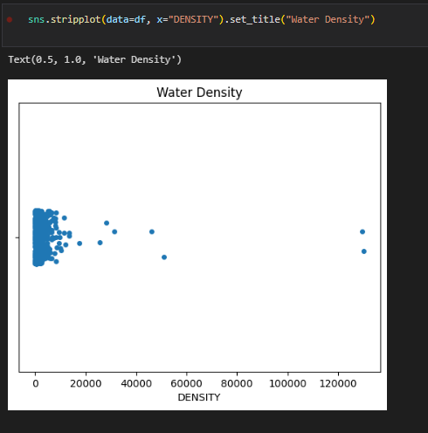
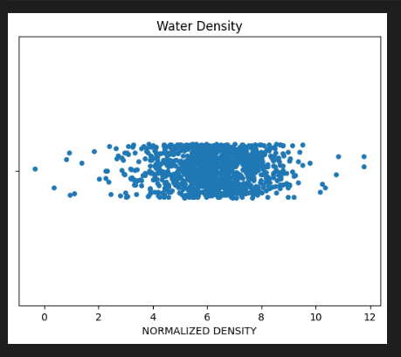
Preprocessing: Processing Target Feature
Make sure pH doesn’t have to be normalized

Slide 21
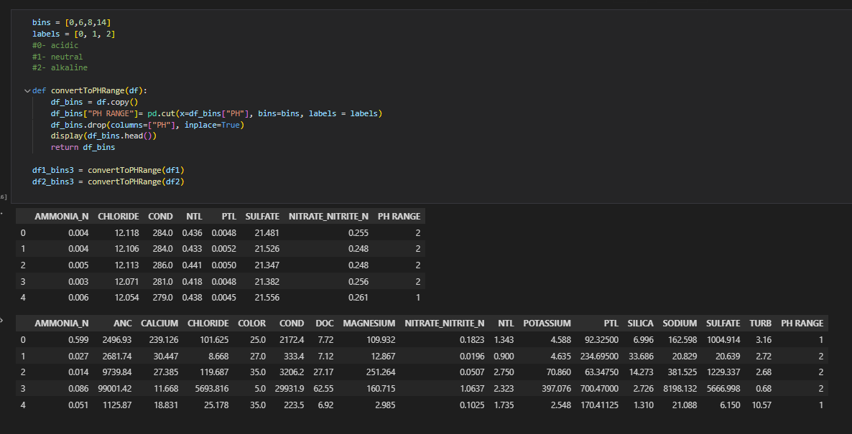
Preprocessing: Splitting Target Feature into Bins
Can use regression (continuous) models
Unsure of how much data is required/accurate results will be

Slide 22
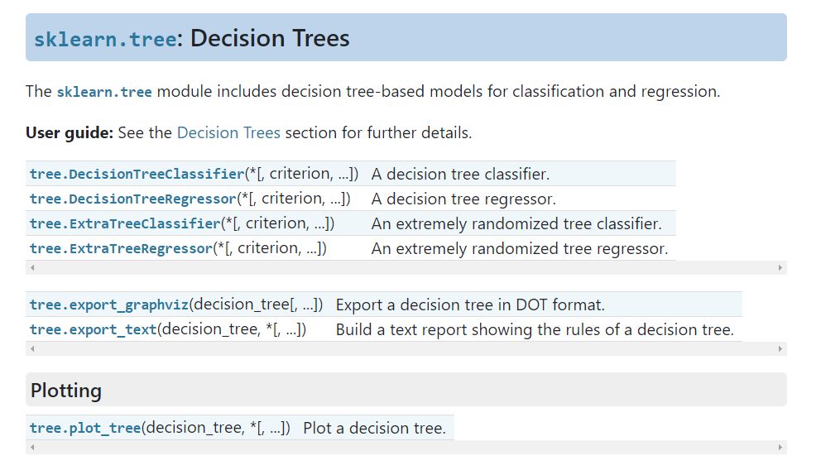
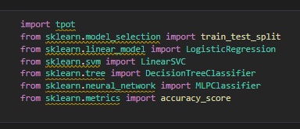
Manual Models: SciKit Website
Several different types of models
Several different submodels within

Slide 23
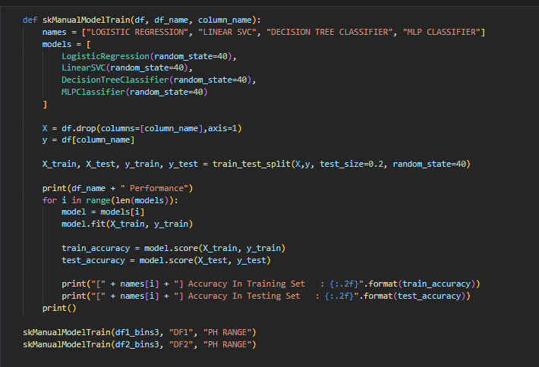
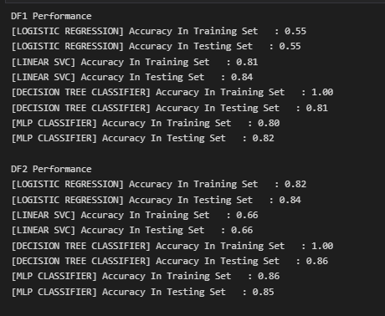
Manual Models: Implementation

Slide 24
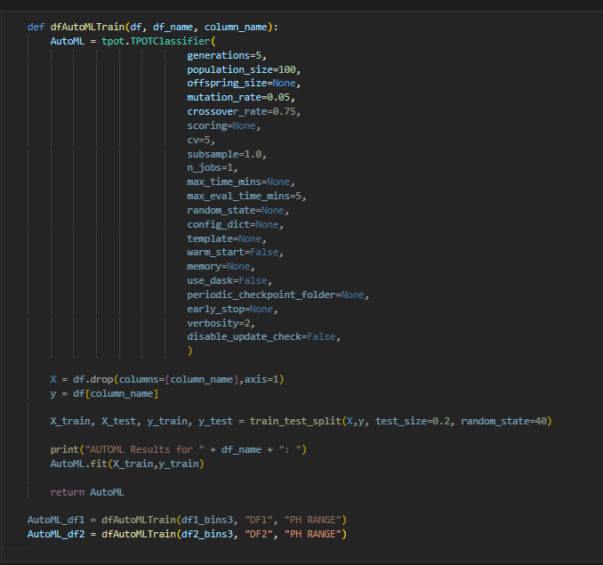
AutoML: Function Overview

Slide 25
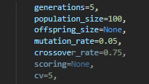
AutoML: Mutation and Crossover Rates
Tested values (Mutation, Crossover):
(0.1, 0.9)
(0.9, 0.1)
(0.95, 0.05)
(0.05, 0.95)
(0.15, 0.85)
(0.2, 0.8)
(0.25, 0.75)
(0.05, 0.75)

Slide 26
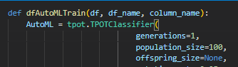
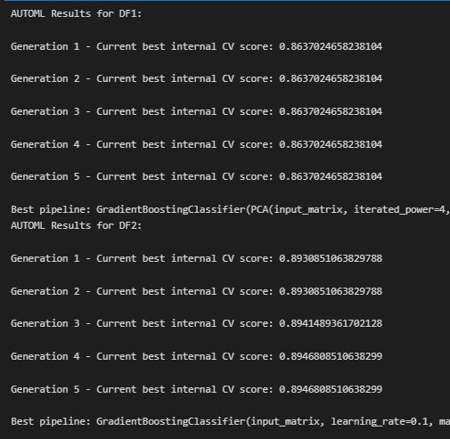
AutoML: Generations = 1

Slide 27
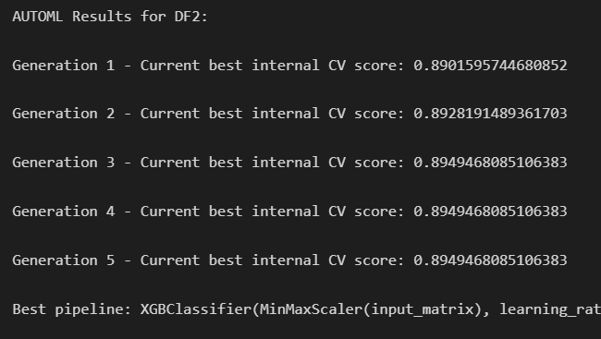
AutoML: Results and Accuracy Analysis

Slide 28
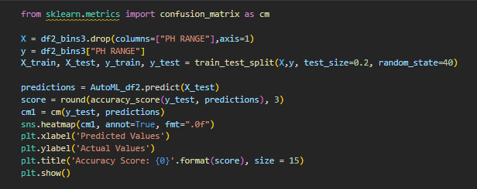
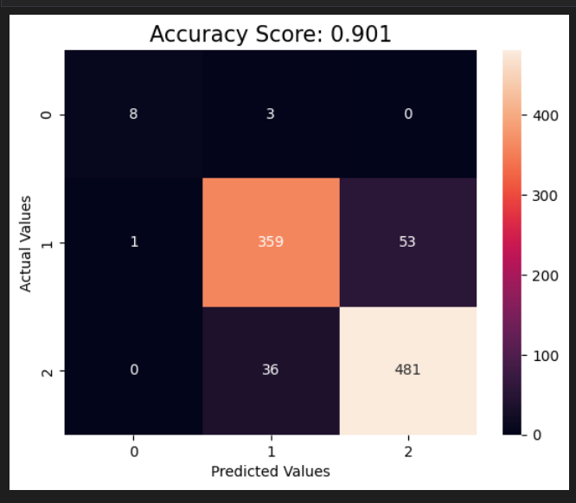
AutoML: Accuracy Analysis

Slide 29
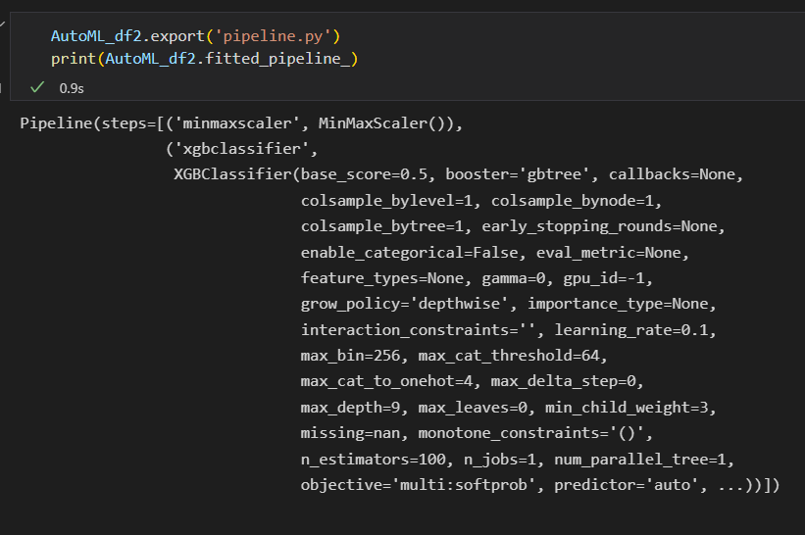
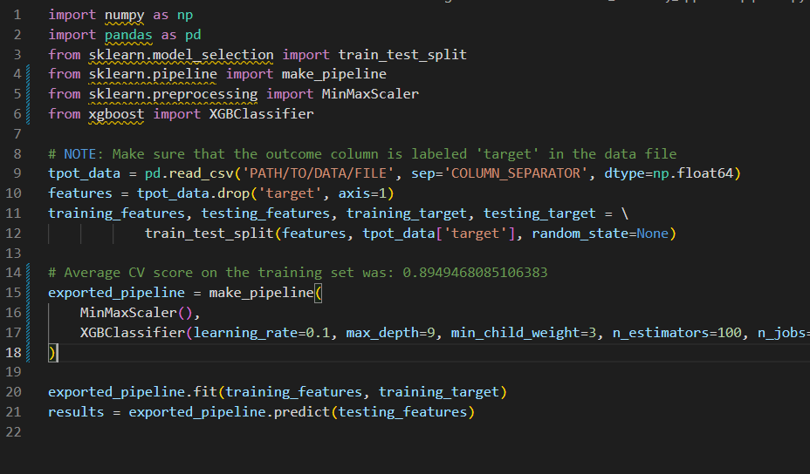
Exporting Results

Slide 30
Exporting Results

Slide 31
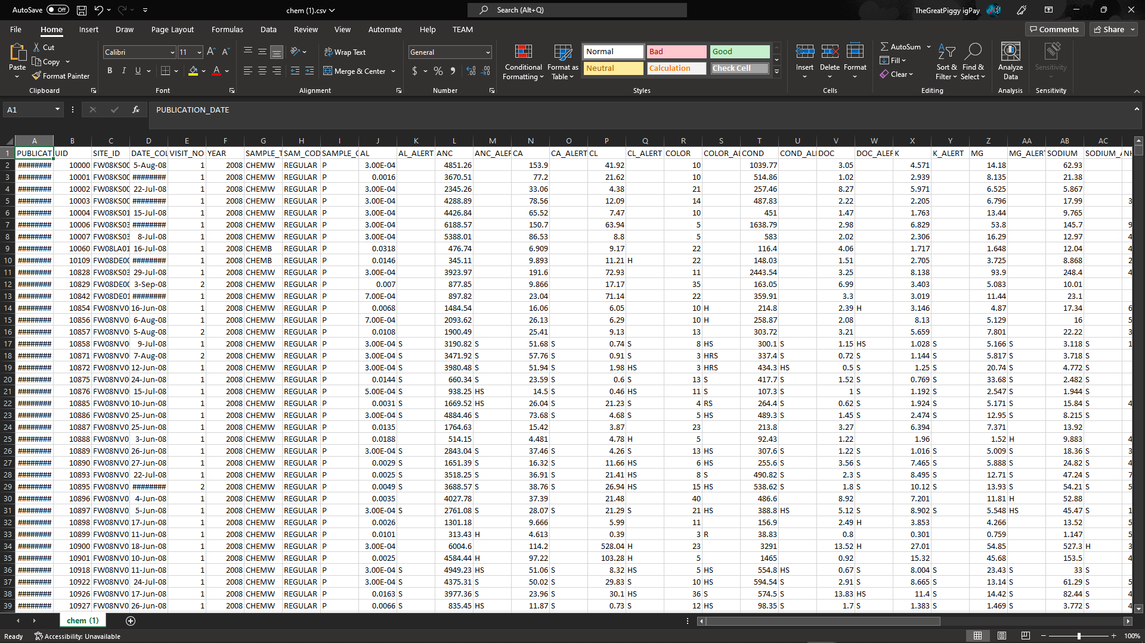
Retrospective: Future Improvements
Try more input feature dimensions than just ~8 or ~16
Get data from other websites
Try another target feature
More generations
Try regression models (?)

Slide 32
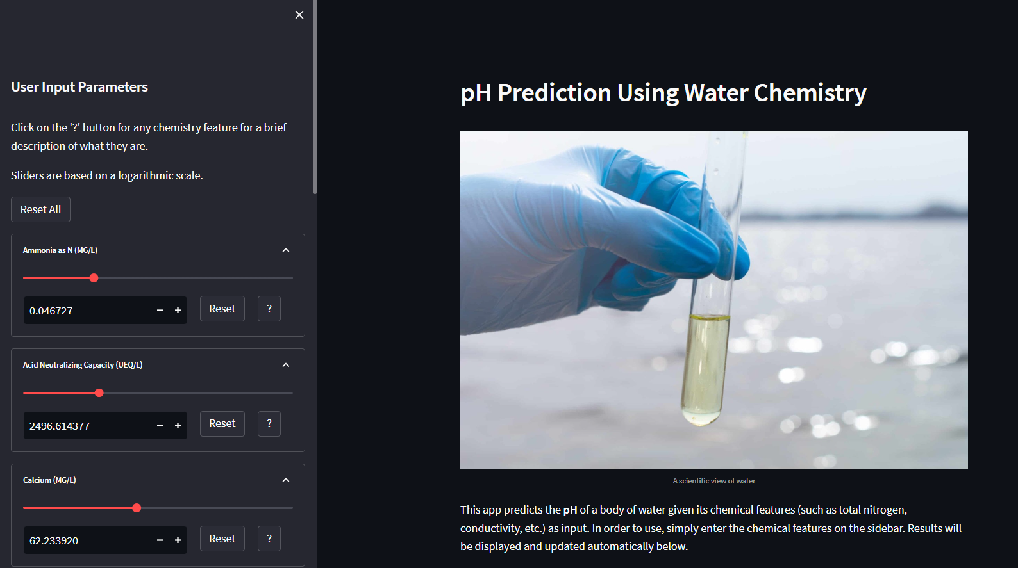
Streamlit Webapp: Current Progress

